Slide 1
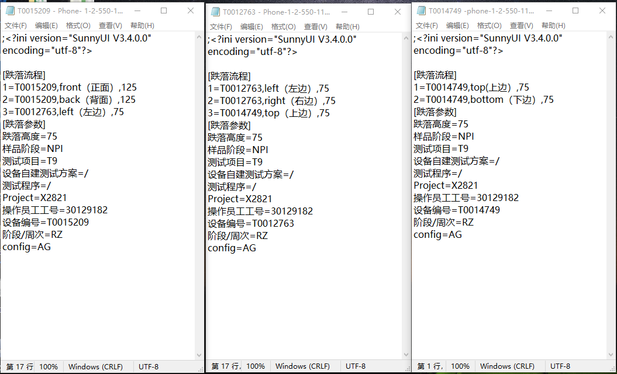
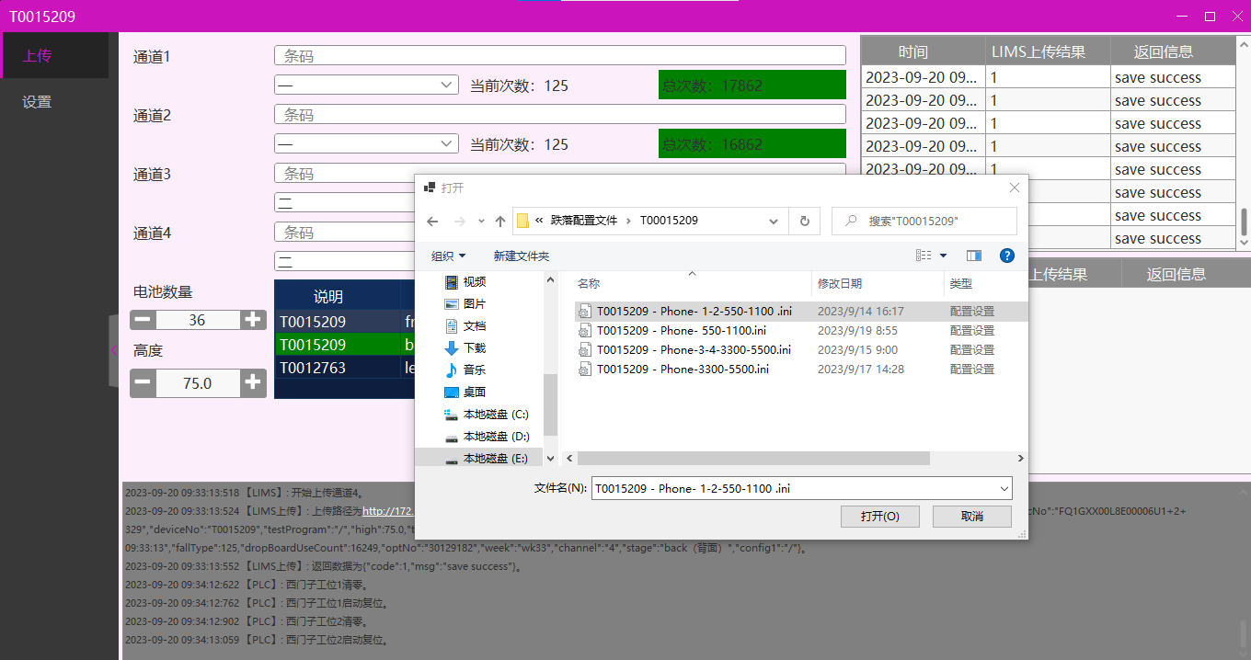
Update H/W, add communication ports
1. Develop new S/W to take records of HSD test
2. Maintenance configuration files, include HSD height, orientation, drop times and sample information.
3. Upload configuration file, HSD machine controlled by software and record test parameters.

Slide 2
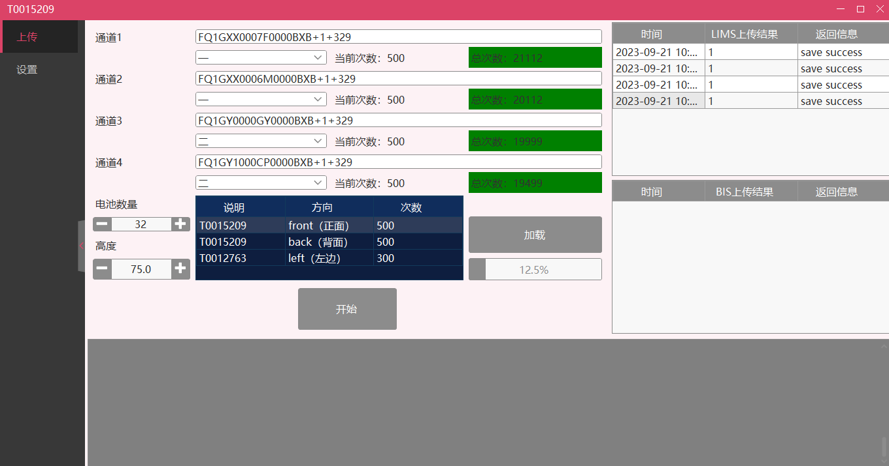
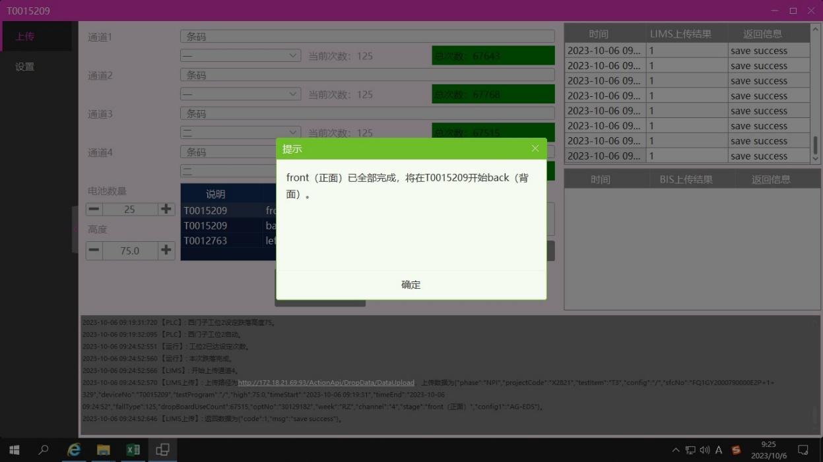
1.Fill in the number of batteries and scan barcode then start test.
2.After test is completed, data upload to LIMS.
3.Once one orientation of the test is completed, jump to the next orientation.
4. When the total number of drops reaches 100000, the device automatically stops, and the test can be restarted after the total number of drops is cleared.

Slide 3
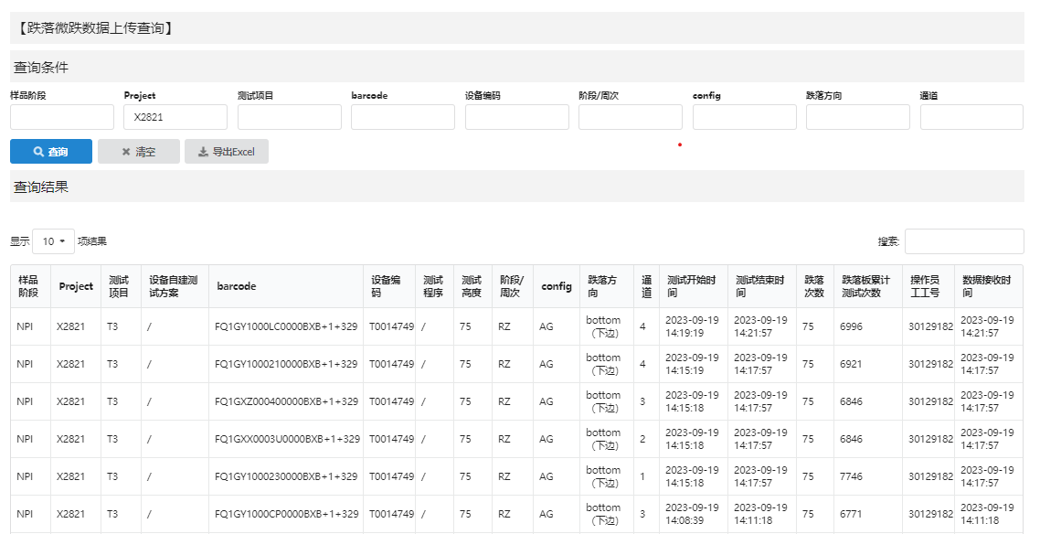
Data upload
All data upload to LIMS, include stage,project,test item,barcode,equipment NO,HSD height,build/WK,config,HSD orientation,channel NO,test start time,test end time,required number of drops per side,total number of drops per particleboard,operator ID.

Slide 4
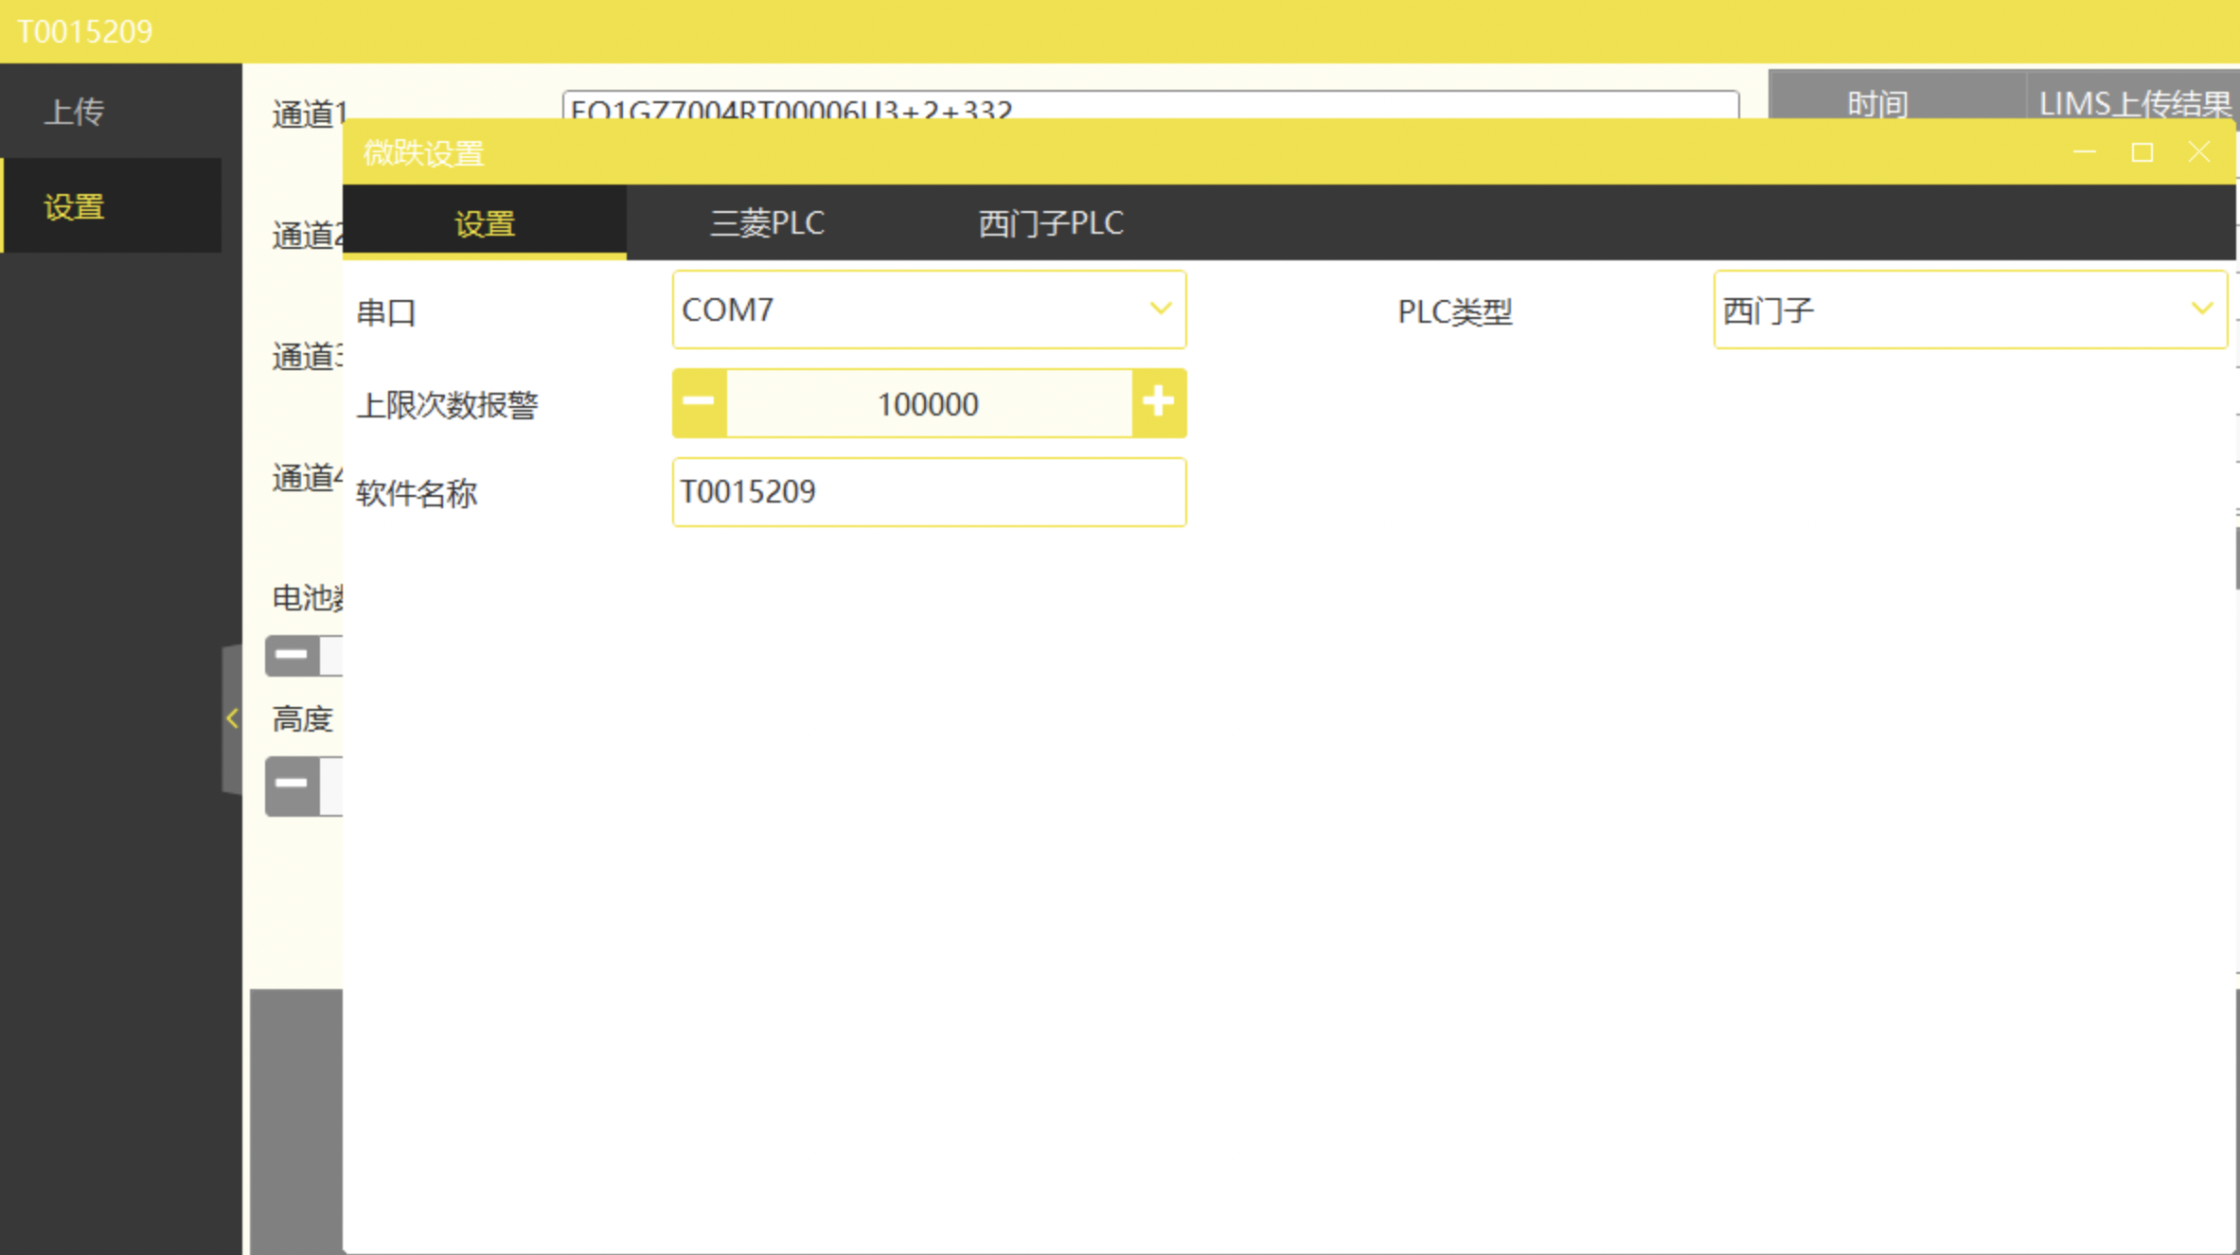
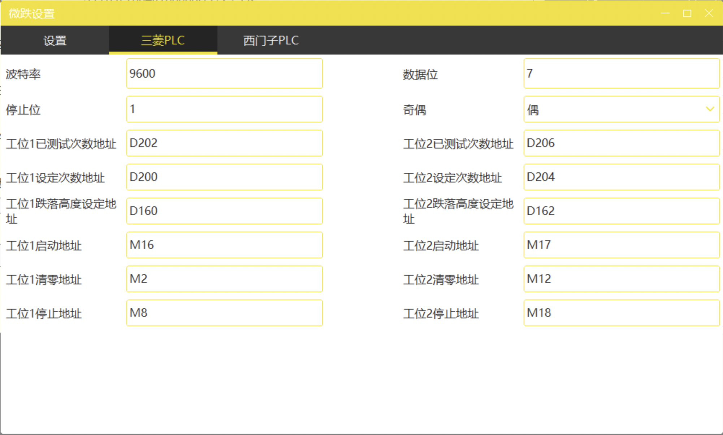
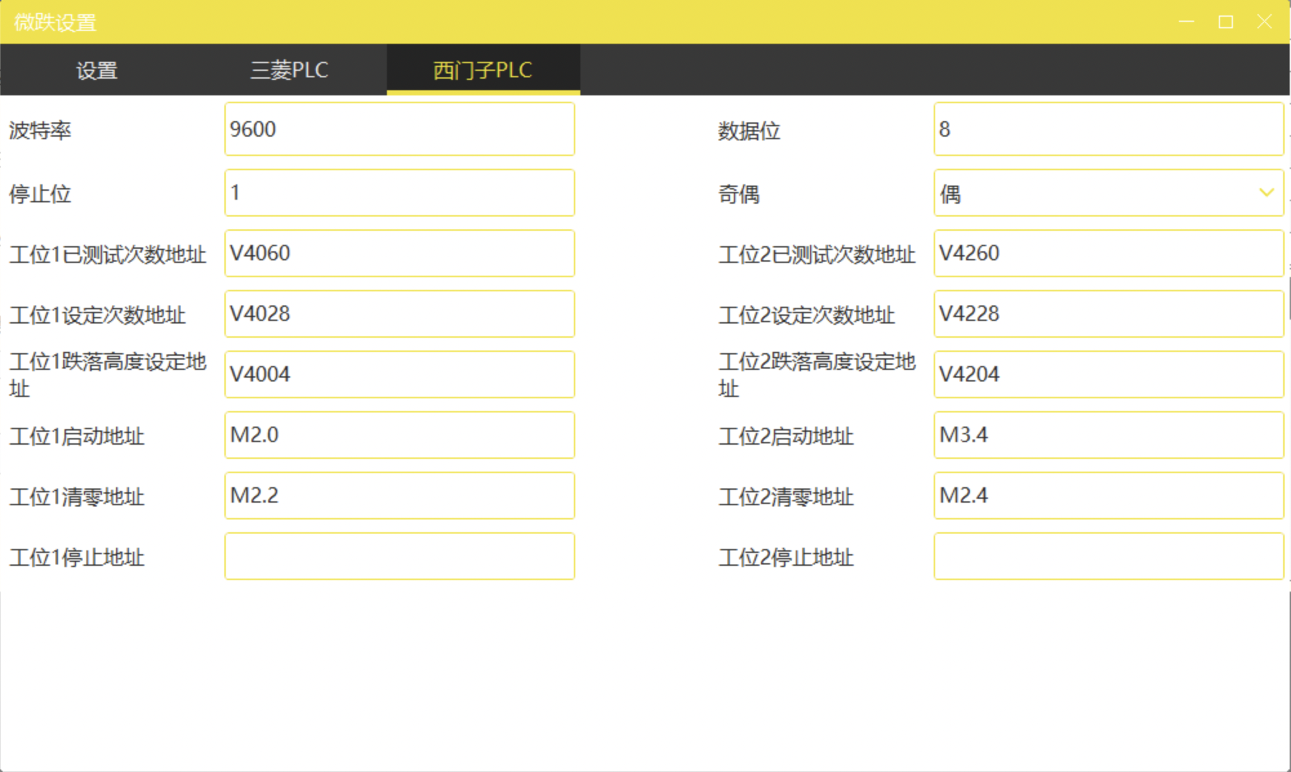
Equipments and software are linked through serial communication, two protocols: the Mitsubishi Computer Link protocol and the Siemens' PPI protocol.

